Slide 1
Dog Breeds

Slide 2
Herding Group
Gather
Herd
Protect

Slide 3
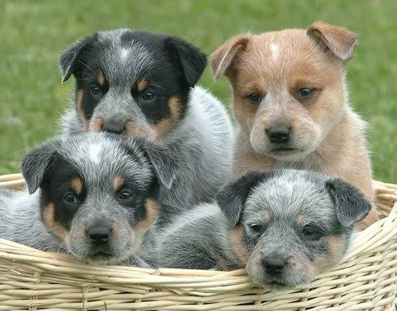
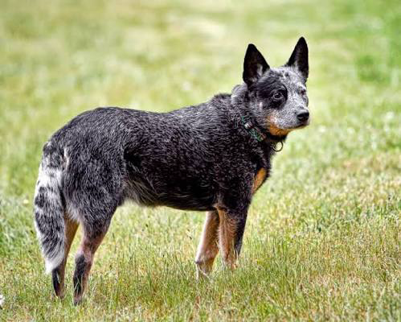
Australian Cattle Dog

Slide 4
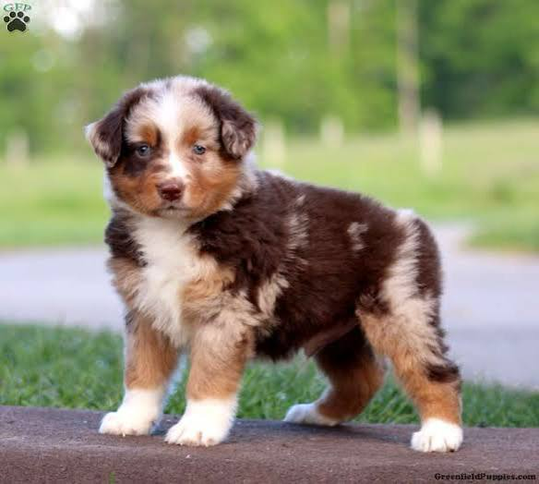
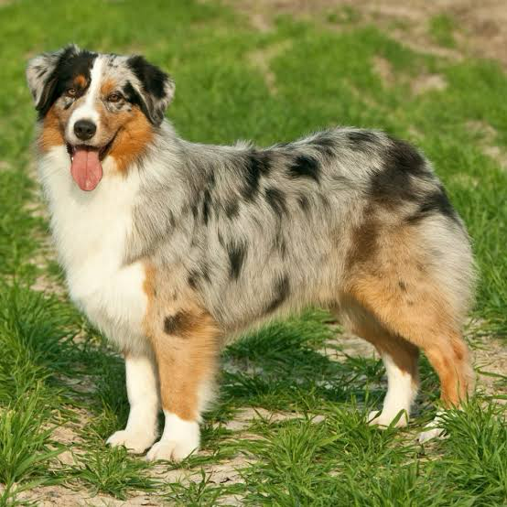
Australian Shepherd

Slide 5
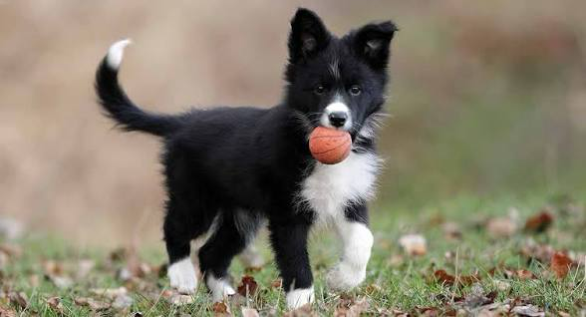
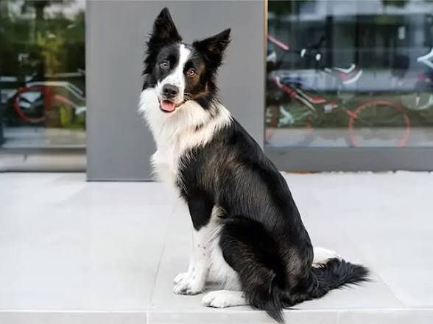
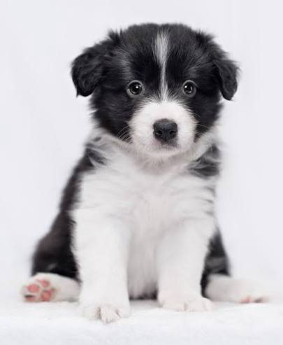
Border Collie

Slide 6
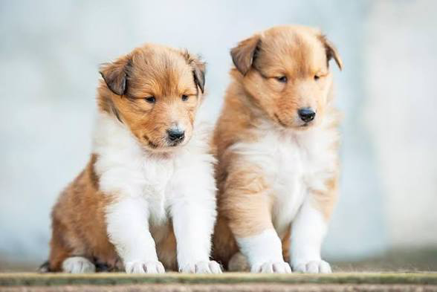
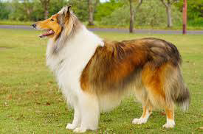
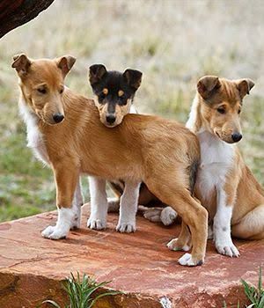
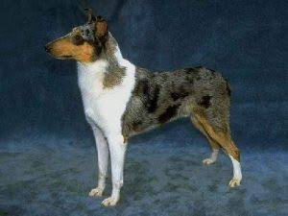
Collie (rough and smooth)

Slide 7
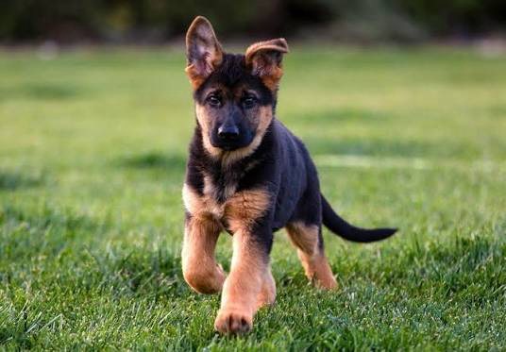
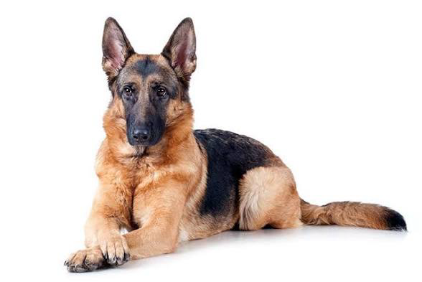
German Shepherd

Slide 8
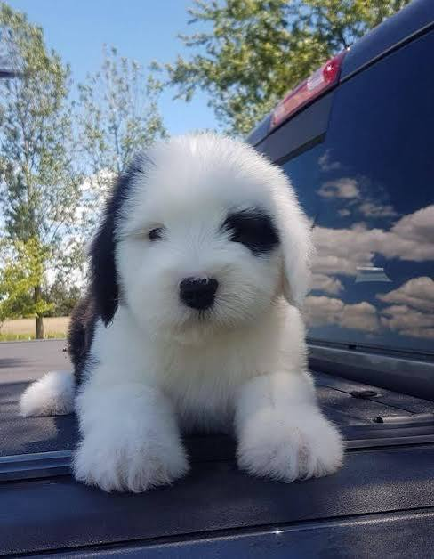
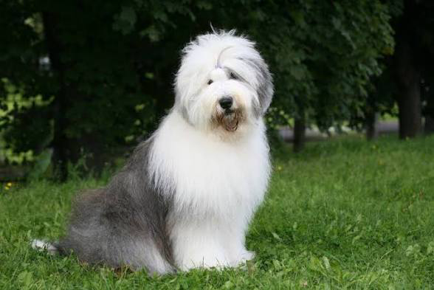
Old English Sheepdog

Slide 9
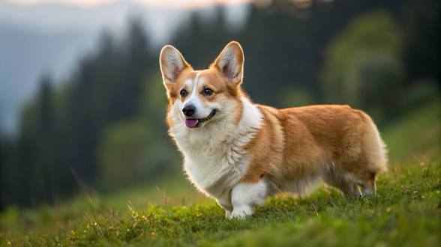
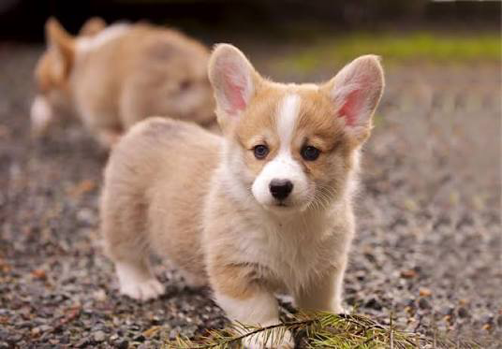
Pembroke Welsh Corgi

Slide 10
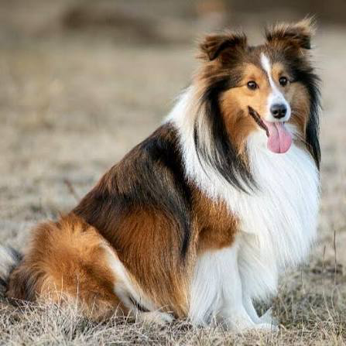
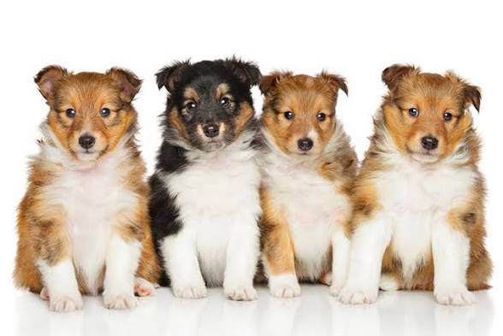
Shetland Sheepdog

Slide 11
Hound group
Strong sense of smell
Tracking
Hunting

Slide 12
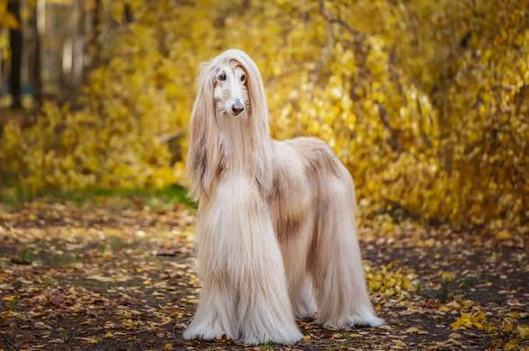
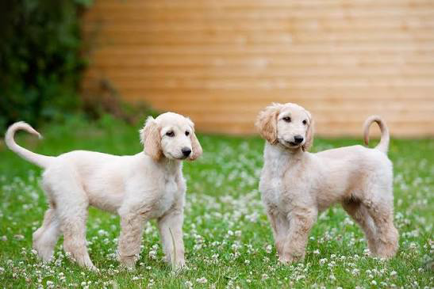
Afghan Hound

Slide 13
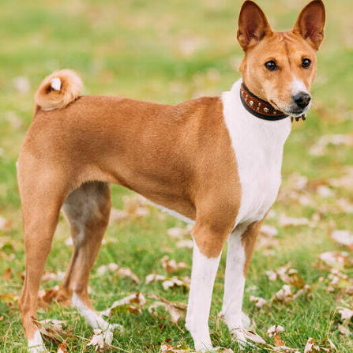
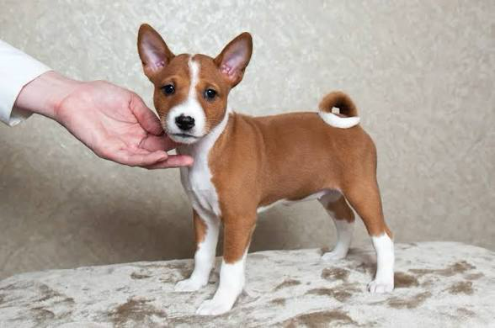
Basenji

Slide 14
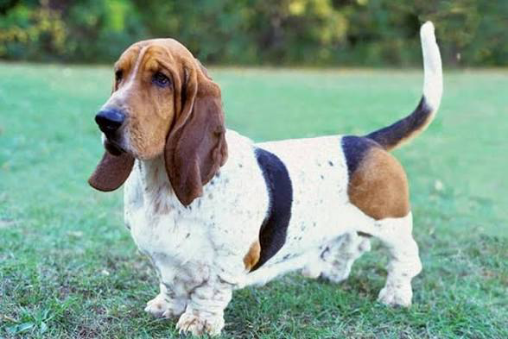
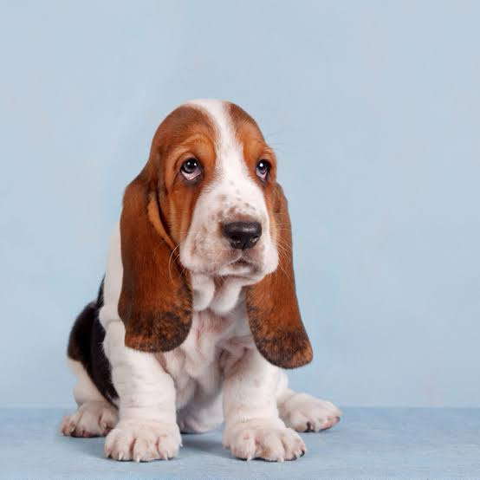
Basset Hound

Slide 15
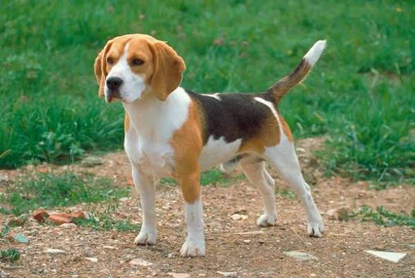
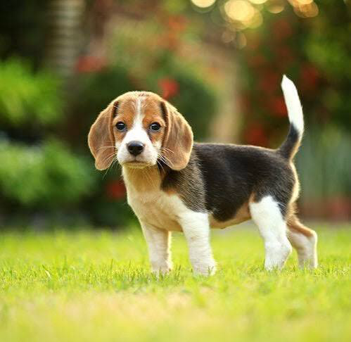
Beagle

Slide 16
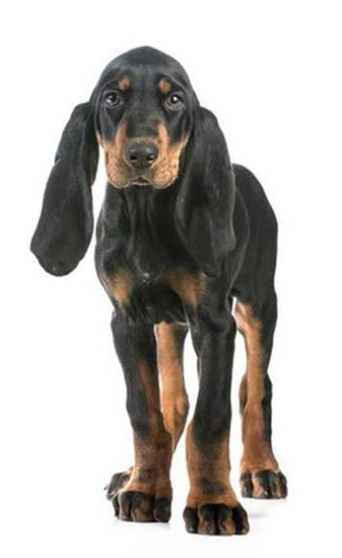
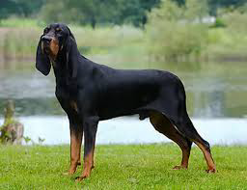
Black and Tan Coonhound

Slide 17
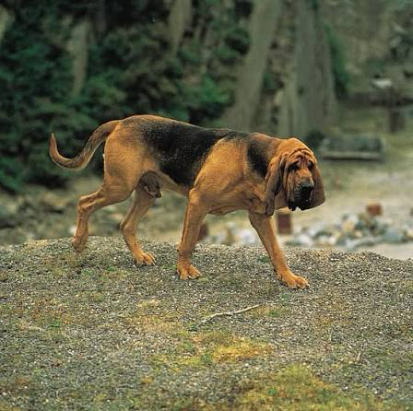
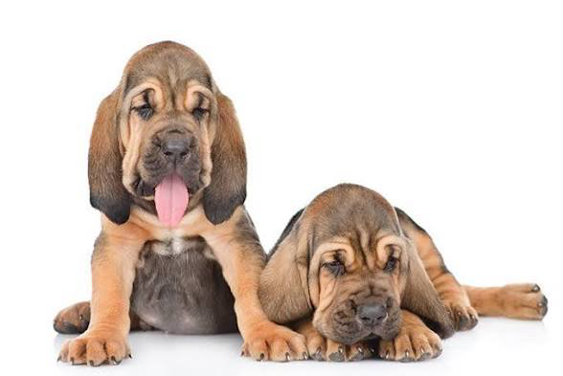
Bloodhound

Slide 18
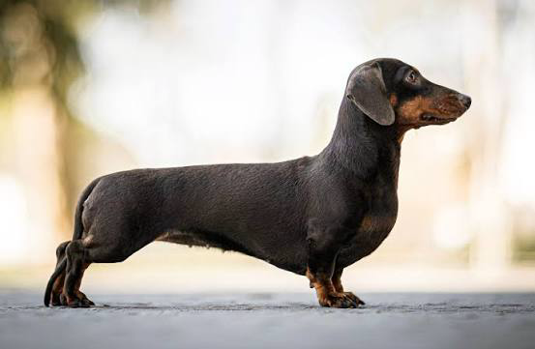
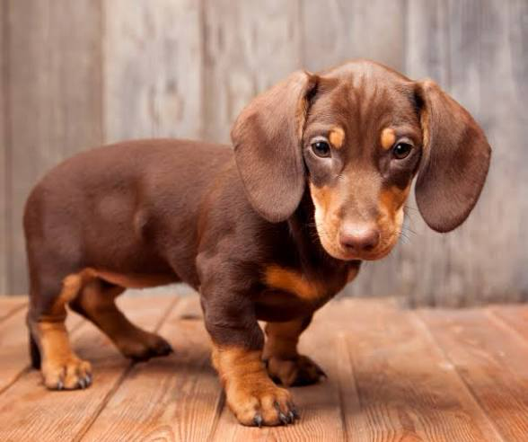
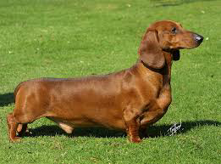
Dachshund

Slide 19
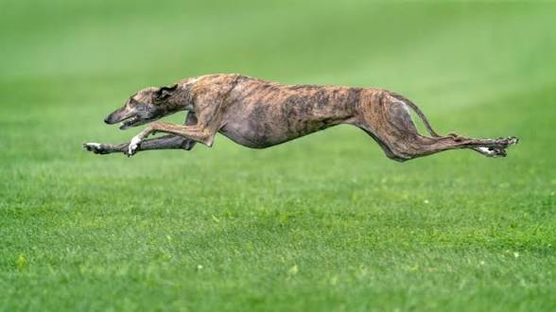
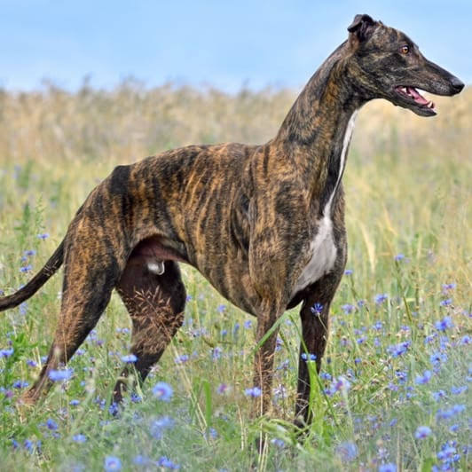
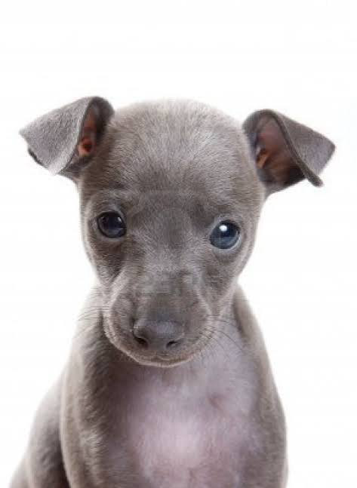
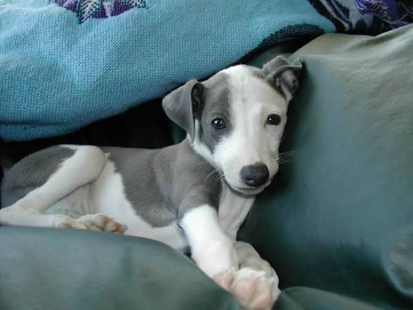
Greyhound

Slide 20
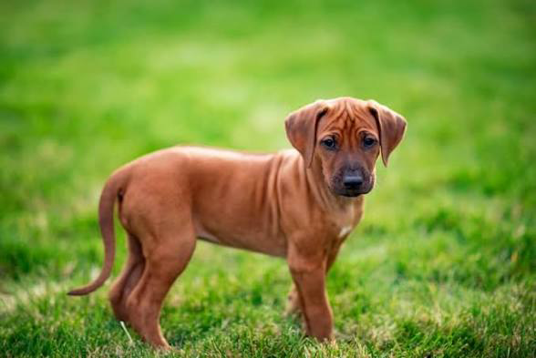
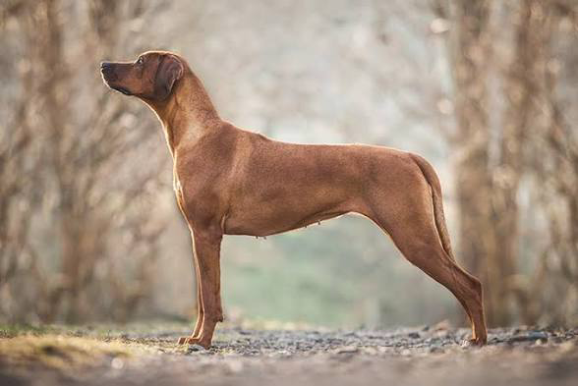
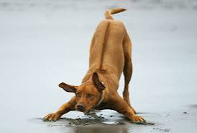
Rhodesian Ridgeback

Slide 21
Non Sporting Group
Diverse
Various sizes
Various colors

Slide 22
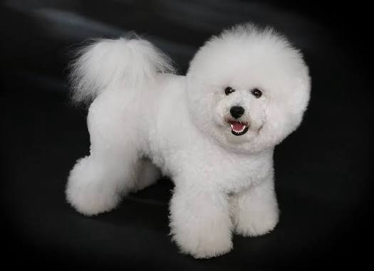
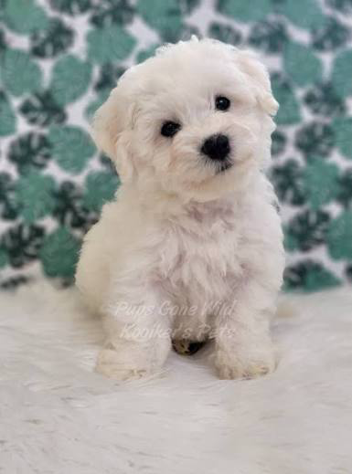
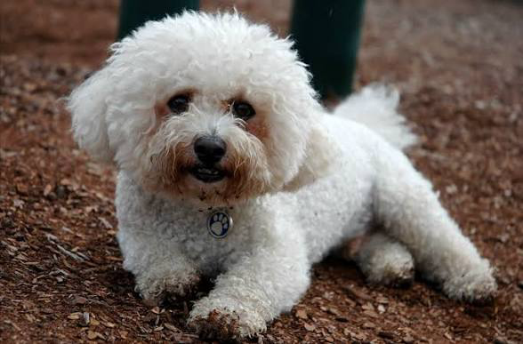
Bichon Frise

Slide 23
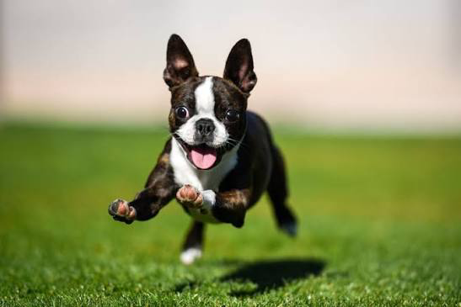
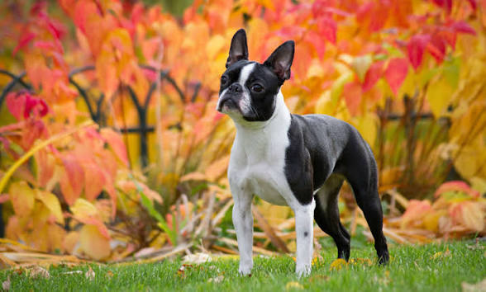
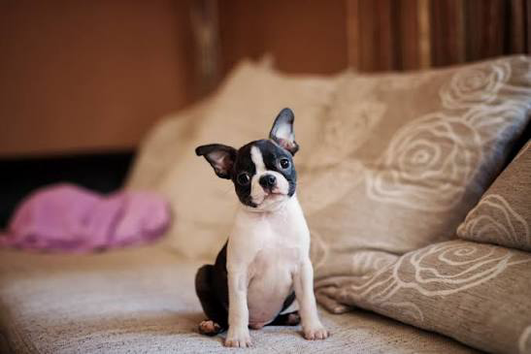
Boston Terrier

Slide 24
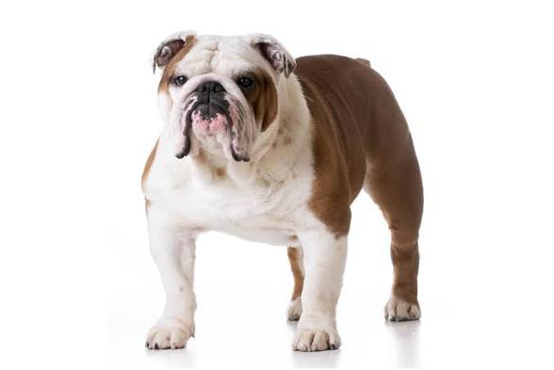
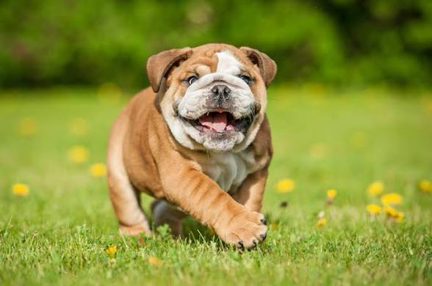
Bulldog

Slide 25
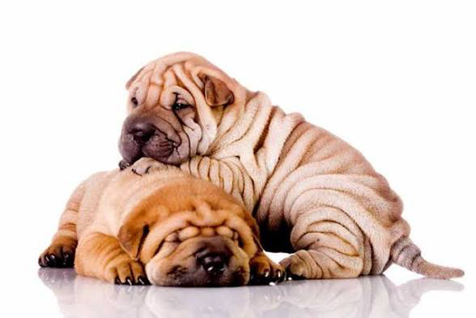

Chinese Shar Pei

Slide 26


Chow Chow

Slide 27


Dalmation

Slide 28


Poodle

Slide 29
Sporting Group
Work with hunters
Find
Flush
Retrieve

Slide 30



Brittany Spaniel

Slide 31



Cocker Spaniel

Slide 32



English Setter

Slide 33


German Shorthair Pointer

Slide 34


Golden Retriever

Slide 35


Irish Setter

Slide 36


Labrador Retriever

Slide 37


Weimaraner

Slide 38
Terrier Group
Bred to hunt vermin
Energetic
Fearless

Slide 39


Bull Terrier

Slide 40



Cairn Terrier

Slide 41


Parson Russell Terrier

Slide 42



Scottish Terrier

Slide 43


West Highland White Terrier

Slide 44
Toy Group
Often miniature stature of full sized breeds
Adaptable to many lifestyles
Small

Slide 45


Cavalier King Charles Spaniel

Slide 46




Chihuahua

Slide 47



Miniature Pinscher

Slide 48



Papillon

Slide 49


Pekingese

Slide 50


Pomeranian

Slide 51



Toy Poodle

Slide 52


Pug

Slide 53


Shih Tzu

Slide 54



Yorkshire Terrier

Slide 55
Working Group
Bred to assist man
Guard
Pull sleds
Water rescues

Slide 56


Bernese Mountain Dog

Slide 57


Boxer

Slide 58




Doberman Pinscher

Slide 59




Great Dane

Slide 60


Great Pyrenese

Slide 61



Mastiff

Slide 62



Newfoundland

Slide 63


Portuguese Water Dogs

Slide 64



Rottweiler

Slide 65


Saint Bernard

Slide 66


Siberian Huskey

Slide 67


Standard Schnauzer

