Slide 1
Vet Science ID
By Brooke Outen 2024/2025

Slide 2
Parasite/Microscopic Identification

Slide 3
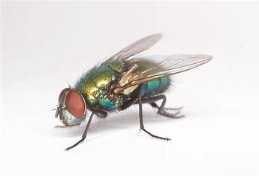
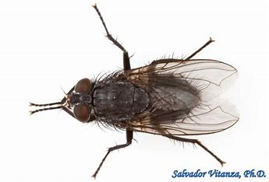
Blowfly (Family Calliphoridae)
.
.

Slide 4
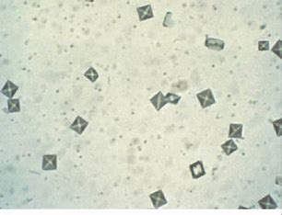
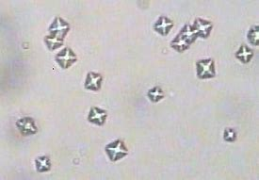
Calcium Oxalate Crystals
.
.

Slide 5
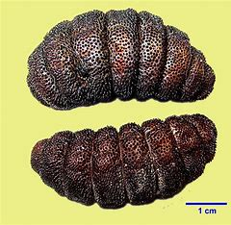
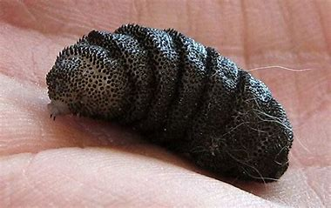
Cat Warble (Genus Cuterebra)
.
.

Slide 6
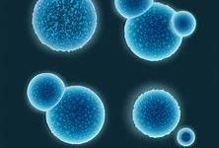
Cocci (Bacteria)
.
.

Slide 7
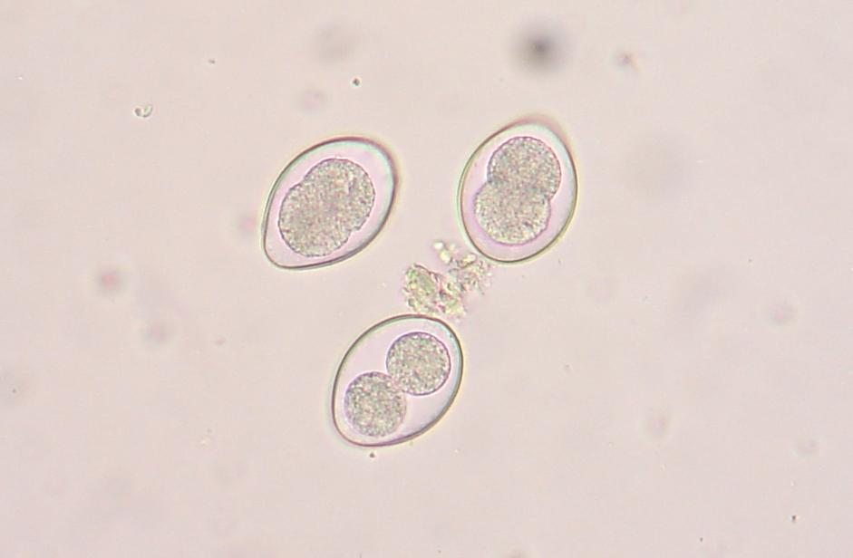
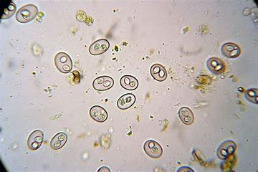
Coccidia (Genus Isospora or Eimeria)
.
.

Slide 8
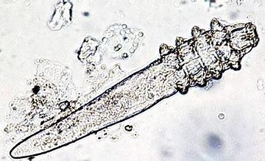
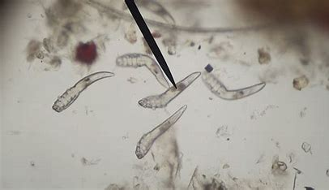
Demodectic Mite (Genus Demodex)
.
.

Slide 9
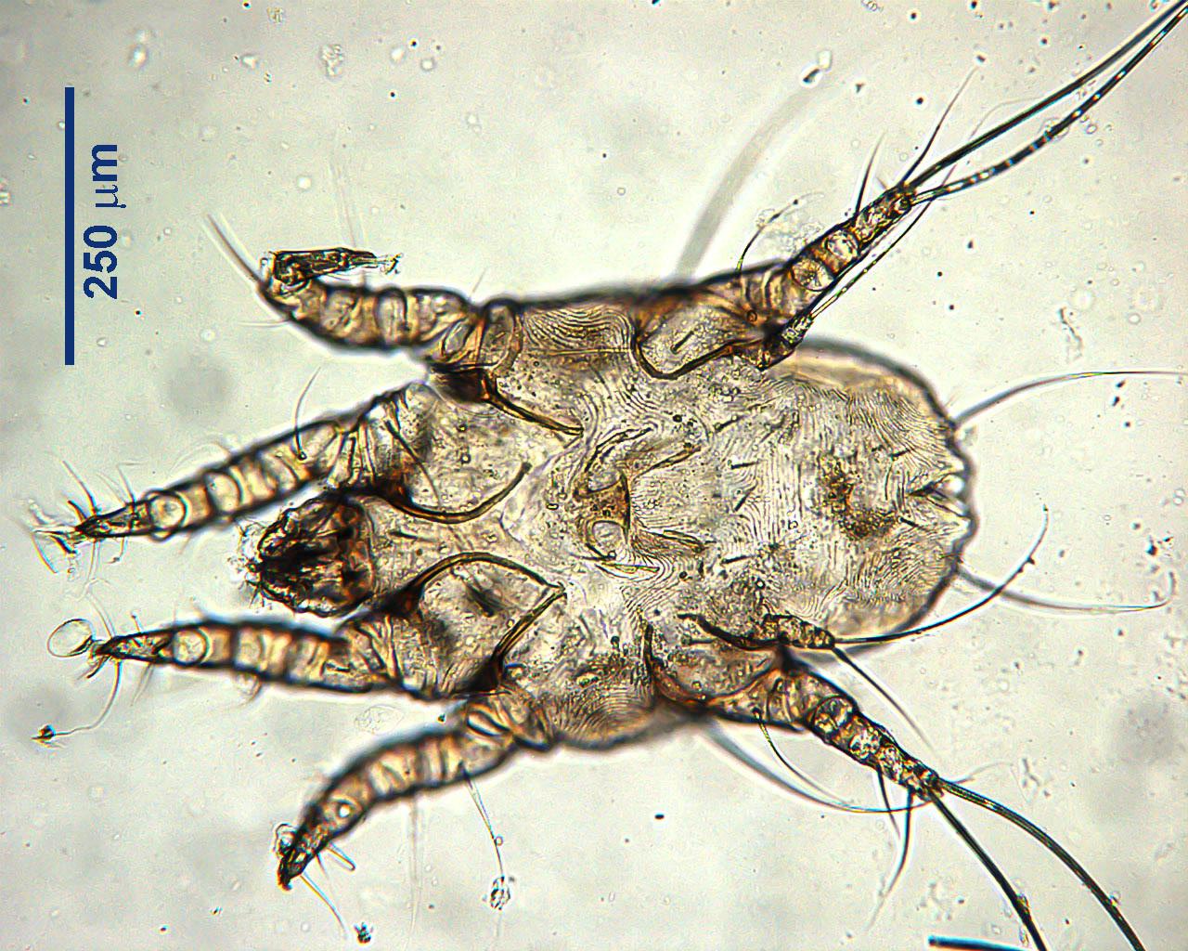
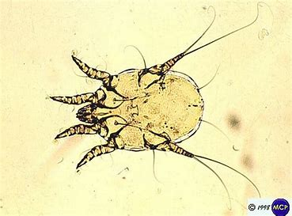
Ear Mite (Family Psoroptidae; Genus Otodectes)
.
.

Slide 10
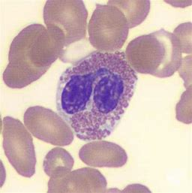
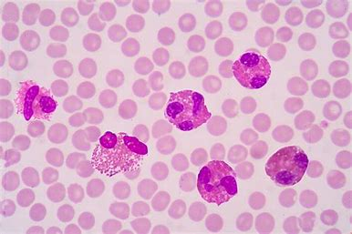
Eosinophils
.
.

Slide 11
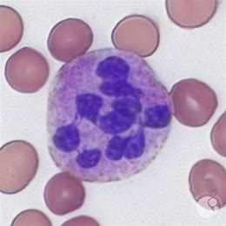
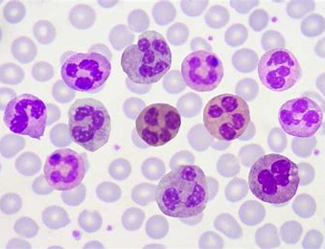
Neutrophils
.
.

Slide 12
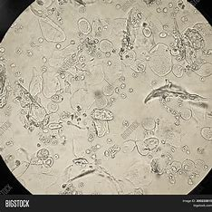
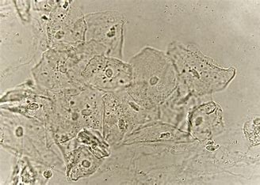
Epithelial Cells (Urine)
.
.

Slide 13
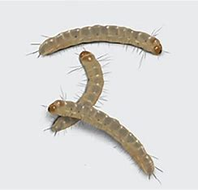
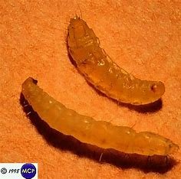
Flea Larva (Genus Ctenocephalides)
.
.

Slide 14
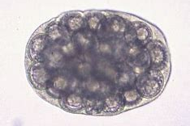
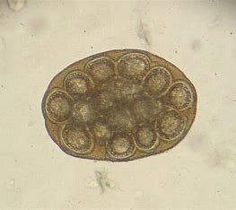
Flea Tapeworm Egg* (Genus Dipylidium)
.
.

Slide 15
Flea Tapeworm Segment* (Genus Dipylidium)
.
.

Slide 16
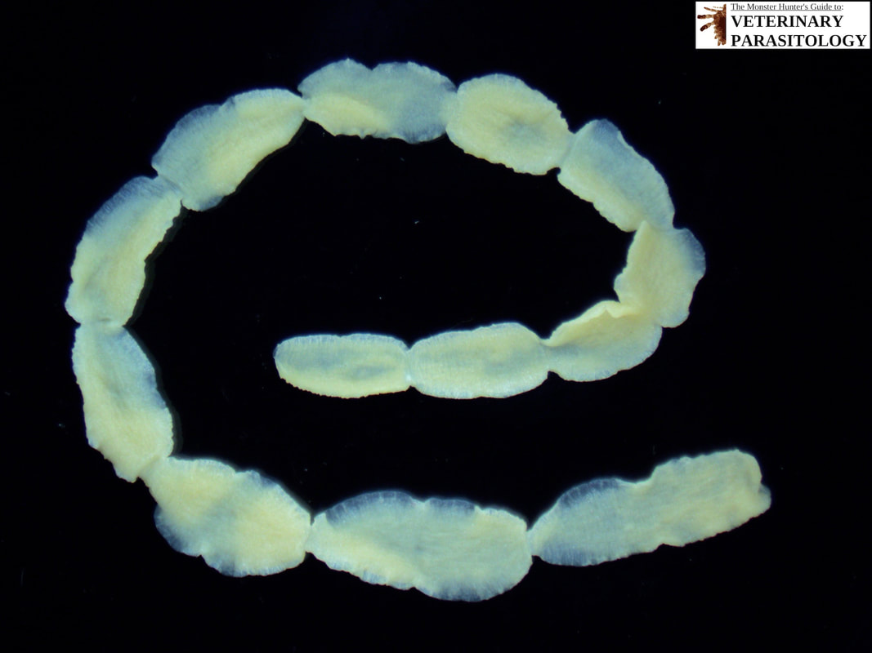
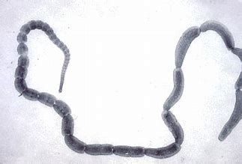
Flea Tapeworm* (Genus Dipylidium)
.
.

Slide 17
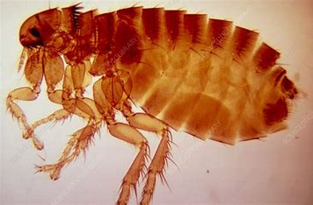
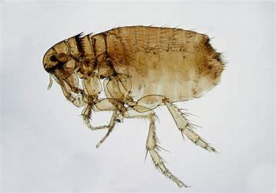
Fleas* (Genus Ctenocephalides)
.
.

Slide 18
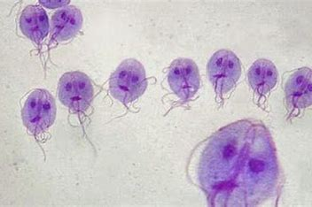
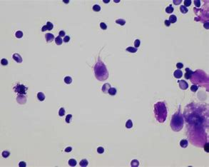
Giardia* (Genus Giardia)
.
.

Slide 19
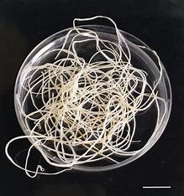
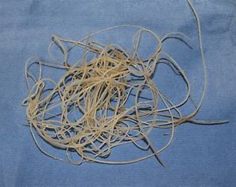
Heartworm Adult* (Genus Dirofilaria)
.
.

Slide 20
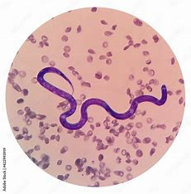
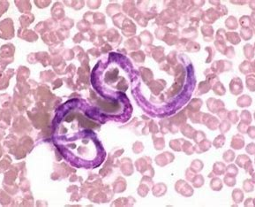
Heartworm Microfilaria* (Genus Dirofilaria)
.
.

Slide 21
Hookworm Adult* (Family Ancylostomatidae; Genus Ancylostoma, Uncinaria, Bunostomum or Globocephalus)
.
.

Slide 22
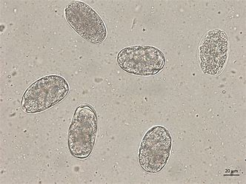
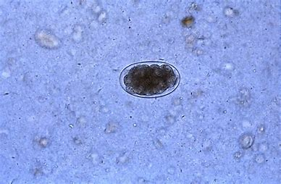
Hookworm Egg* (Family Ancylostomatidae; Genus Ancylostoma, Uncinaria, Bunostomum or Globocephalus)
.
.

Slide 23
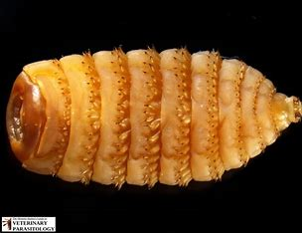
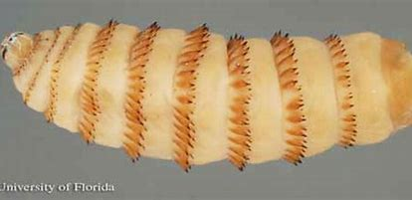
Horse Bots* (Genus Gasterophilus)
.
.

Slide 24
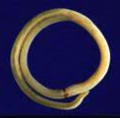
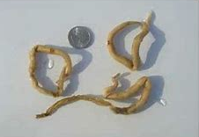
Horse Strongyles* (Family Strongylidae; Genus Strongylus)
.
.

Slide 25
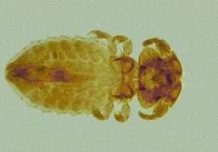
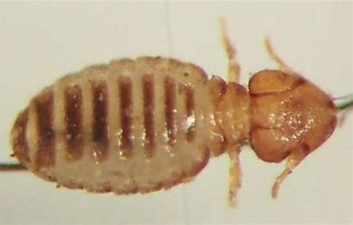
Lice - Biting (Order Mallophaga; Genus Bovicola or Trichodectes)
.
.

Slide 26
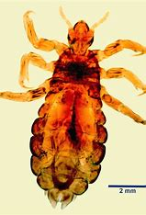
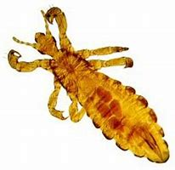
Lice - Sucking (Order Anoplura; Genus Linognathus or Hematopinus)
.
.

Slide 27
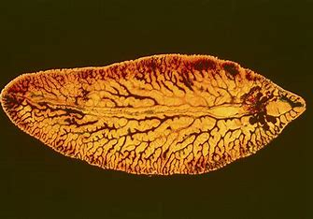
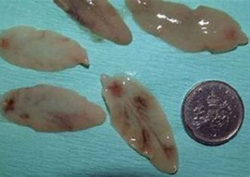
Liver Fluke (Class Trematoda; Genus Fasciola, Fascioloides or Dicrocoelium)
.
.

Slide 28
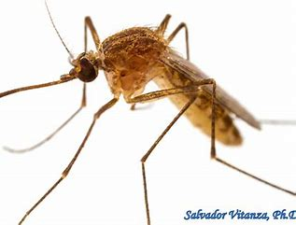
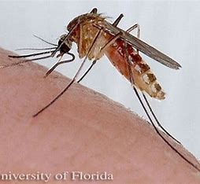
Mosquito Adult (Family Culicidae; Genus Anopheles, Culex or Aedes)
.
.

Slide 29
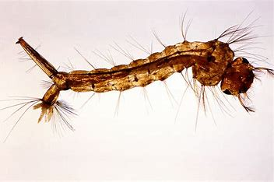
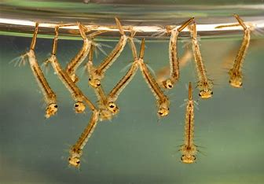
Mosquito Larva (Family Culicidae; Genus Anopheles, Culex or Aedes)
.
.

Slide 30
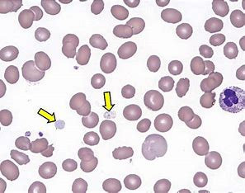
Platelets
.
.

Slide 31
Red Blood Cell (Mammalian)
.
.

Slide 32
Red Blood Cell (Avian)
.
.

Slide 33
Rod (Bacteria)
.
.

Slide 34
Roundworm Adult* (Family Ascarididae or Toxocaridae; Genus Toxocara, Toxascaris, Ascaris, Parascaris or Neoascaris)
.
.

Slide 35
Roundworm Egg* (Family Ascarididae or Toxocaridae; Genus Toxocara, Toxascaris, Ascaris, Parascaris or Neoascaris)
.
.

Slide 36
Sarcoptic Mite (Family Sarcoptidae; Genus Sarcoptes or Notoedres)
.
.

Slide 37
Struvite Crystals (Triple Magnesium Phosphate)
.
.

Slide 38
Taenia Tapeworm Egg* (Family Taeniidae; Genus Taenia)
.
.

Slide 39
Taenia Tapeworm Segment* (Family Taeniidae; Genus Taenia)
.
.

Slide 40
Taenia Tapeworm* (Family Taeniidae; Genus Taenia
.
.

Slide 41
Tick - American Dog (Family Dermacentor; Genus Variabilis)
.
.

Slide 42
Tick - Black Legged Deer (Family Ixodes; Genus Scapularis)
.
.

Slide 43
Tick - Brown Dog (Family Rhipicephalus; Genus Sanguineus)
.
.

Slide 44
Tick - Lonestar (Family Amblyomma; Genus Americanum)
.
.

Slide 45
Whipworm Egg* (Genus Trichuris)
.
.

Slide 46
Whipworm* (Genus Trichuris)
.
.

Slide 47
Yeast (Cytology)
.
.

Slide 48
Equipment/Material Identification

Slide 49
Ambubag
.
.

Slide 50
Anesthetic Machines
.
.

Slide 51
Autoclave
.
.

Slide 52
Autoclave Tape Indicator
.
.

Slide 53
Backhaus Towel Clamps
.
.

Slide 54
Balling Gun
.
.

Slide 55
Bandaging Material - Elasticon
.
.

Slide 56
Bandaging Material - Roll Gauze
.
.

Slide 57
Bandaging Material - Vet Wrap
.
.

Slide 58
Bands (Castration or Docking)
.
.

Slide 59
Cat Bag
.
.

Slide 60
Catch Pole (Dog Snare)
.
.

Slide 61
Catheter - Butterfly
.
.

Slide 62
Catheter - IV
.
.

Slide 63
Catheter - Tomcat Urinary
.
.

Slide 64
Cautery
.
.

Slide 65
Centrifuge
.
.

Slide 66
Chemical Indicator Strips
.
.

Slide 67
Cold Sterile Tray
.
.

Slide 68
Dehorner - Barnes
.
.

Slide 69
Dehorner - Electric
.
.

Slide 70
Dental/Power Floats
.
.

Slide 71
Dental Scaler
.
.

Slide 72
Drench Gun - Small Ruminant
.
.

Slide 73
Ear Notcher
.
.

Slide 74
Ear Tagger - Large Animal
.
.

Slide 75
Elastrator
.
.

Slide 76
Electronic ID Reader
.
.

Slide 77
Elizabethan Collar
.
.

Slide 78
Emasculators
.
.

Slide 79
Endoscope
.
.

Slide 80
Endotracheal Tubes
.
.

Slide 81
Fecal Loop
.
.

Slide 82
Fecalyzers
.
.

Slide 83
Feeding Tube for Small Animals
.
.

Slide 84
Fetal Extractor - Calf
.
.

Slide 85
Forceps - Allis Tissue
.
.

Slide 86
Forceps - Alligator
.
.

Slide 87
Forceps - Babcock Tissue
.
.

Slide 88
Forceps - Brown-Adson Thumb
.
.

Slide 89
Forceps - Crile
.
.

Slide 90
Forceps - Kelly
.
.

Slide 91
Forceps - Halstead Mosquito Hemostatic
.
.

Slide 92
Forceps - Rochester Carmalt
.
.

Slide 93
Forceps - Rat Tooth Thumb
.
.

Slide 94
Gravity Feeder/J Tube
.
.

Slide 95
Head Gate
.
.

Slide 96
Hog Snare
.
.

Slide 97
IV Fluid Bag
.
.

Slide 98
Hoof Knife
.
.

Slide 99
Hoof Rasp
.
.

Slide 100
IV Administration Set
.
.

Slide 101
Laparoscope
.
.

Slide 102
Laryngoscopes
.
.

Slide 103
Muzzle - Basket
.
.

Slide 104
Muzzle - Nylon
.
.

Slide 105
Needle Holder - Mayo-Hegar
.
.

Slide 106
Needle Holder - Olsen-Hegar
.
.

Slide 107
Obstetrical Chain and Handle
.
.

Slide 108
Ophthalmoscope
.
.

Slide 109
Otoscope
.
.

Slide 110
Pig Tooth Nippers
.
.

Slide 111
Radiology Personal Protective Equipment
.
.

Slide 112
Rectal Prolapse Ring - Swine
.
.

Slide 113
Rumen Magnet
.
.

Slide 114
Scalpel Blade
.
.

Slide 115
Scalpel Handle
.
.

Slide 116
Scissors - Suture Wire Cutting
.
.

Slide 117
Scissors - Utility Bandage
.
.

Slide 118
Scissors - Lister Bandage
.
.

Slide 119
Scissors - Littauer Suture Removal
.
.

Slide 120
Scissors - Mayo Dissecting
.
.

Slide 121
Scissors - Metzenbaum Dissecting
.
.

Slide 122
Silver Nitrate Sticks
.
.

Slide 123
Small Animal Oxygen Cage
.
.

Slide 124
Snook Ovariohysterectomy Hook
.
.

Slide 125
Speculum - Equine
.
.

Slide 126
Speculum - Frick/Bovine
.
.

Slide 127
Speculum - Small Animal Oral
.
.

Slide 128
Speculum - Vaginal
.
.

Slide 129
Squeeze Chute
.
.

Slide 130
Staple Remover
.
.

Slide 131
Stethoscope
.
.

Slide 132
Surgical Drapes
.
.

Slide 133
Suture Needle - Cutting
.
.

Slide 134
Suture Needle - Taper
.
.

Slide 135
Syringe - Automatic, Multidose
.
.

Slide 136
Syringe - Luer Lock
.
.

Slide 137
Syringe - Slip Tip
.
.

Slide 138
Tattooing Instruments - Small and Large
.
.

Slide 139
Tonometer
.
.

Slide 140
Tourniquet
.
.

Slide 141
Trocar and Cannula
.
.

Slide 142
Twitch - Chain
.
.

Slide 143
Twitch - Humane
.
.

Slide 144
Animal
Identification

Slide 145
Herding Group Identification

Slide 146
Australian Cattle Dog
.
.

Slide 147
Australian Shepherd
.
.

Slide 148
Border Collie
.
.

Slide 149
Collie
.
.

Slide 150
Shetland Sheepdog
.
.

Slide 151
German Shepherd Dog
.
.

Slide 152
Old English Sheepdog
.
.

Slide 153
Pembroke Welsh Corgi
.
.

Slide 154
Hound Group Identification

Slide 155
Afghan Hound
.
.

Slide 156
Basenji
.
.

Slide 157
Basset Hound
.
.

Slide 158
Beagle
.
.

Slide 159
Black and Tan Coonhound
.
.

Slide 160
Bloodhound
.
.

Slide 161
Dachshund
.
.

Slide 162
Greyhound
.
.

Slide 163
Rhodesian Ridgeback
.
.

Slide 164
Non-Sporting Group Identification

Slide 165
Bichon Frise
.
.

Slide 166
Boston Terrier
.
.

Slide 167
Bulldog
.
.

Slide 168
Chinese Shar-Pei
.
.

Slide 169
Chow Chow
.
.

Slide 170
Dalmatian
.
.

Slide 171
Poodle
.
.

Slide 172
Sporting Group Identification

Slide 173
Brittany Spaniel
.
.

Slide 174
Cocker Spaniel
.
.

Slide 175
English Setter
.
.

Slide 176
German Shorthaired Pointer
.
.

Slide 177
Golden Retriever
.
.

Slide 178
Irish Setter
.
.

Slide 179
Labrador Retriever
.
.

Slide 180
Weimaraner
.
.

Slide 181
Terrier Group Identification

Slide 182
Bull Terrier
.
.

Slide 183
Cairn Terrier
.
.

Slide 184
Parson Russell Terrier
.
.

Slide 185
Scottish Terrier
.
.

Slide 186
West Highland White Terrier
.
.

Slide 187
Toy Group
Identification

Slide 188
Cavalier King Charles Spaniel
.
.

Slide 189
Chihuahua
.
.

Slide 190
Miniature Pinscher
.
.

Slide 191
Papillon
.
.

Slide 192
Pekingese
.
.

Slide 193
Pomeranian
.
.

Slide 194
Toy Poodle
.
.

Slide 195
Pug
.
.

Slide 196
Shih Tzu
.
.

Slide 197
Yorkshire Terrier
.
.

Slide 198
Working Group Identification

Slide 199
Bernese Mountain Dog
.
.

Slide 200
Boxer
.
.

Slide 201
Doberman Pinscher
.
.

Slide 202
Great Dane
.
.

Slide 203
Great Pyrenees
.
.

Slide 204
Mastiff
.
.

Slide 205
Newfoundland
.
.

Slide 206
Portuguese Water Dog
.
.

Slide 207
Rottweiler
.
.

Slide 208
Saint Bernard
.
.

Slide 209
Siberian Husky
.
.

Slide 210
Standard Schnauzer
.
.

Slide 211
Cats
Identification

Slide 212
Abyssinian
.
.

Slide 213
American Shorthair
.
.

Slide 214
Burmese
.
.

Slide 215
Maine Coon
.
.

Slide 216
Manx
.
.

Slide 217
Persian
.
.

Slide 218
Ragdoll
.
.

Slide 219
Russian Blue
.
.

Slide 220
Siamese
.
.

Slide 221
Sphynx
.
.

Slide 222
Birds
Identification

Slide 223
African Gray Parrot
.
.

Slide 224
Canary
.
.

Slide 225
Cockatiel
.
.

Slide 226
Cockatoos
.
.

Slide 227
Love Birds
.
.

Slide 228
Macaw
.
.

Slide 229
Parakeet
.
.

Slide 230
Sun Conure
.
.

Slide 231
Zebra Finch
.
.

Slide 232
Poultry
Identification

Slide 233
Chicken-Cornish Cross Broiler
.
.

Slide 234
Chicken-White Leghorns
.
.

Slide 235
Chicken-Plymouth Rock
.
.

Slide 236
Chicken-Rhode Island Red
.
.

Slide 237
Duck-White Pekin
.
.

Slide 238
Duck-Khaki Campbell
.
.

Slide 239
Duck-Runner
.
.

Slide 240
Geese-Embden
.
.

Slide 241
Quail-Coturnix
.
.

Slide 242
Turkey-Broad Breasted White
.
.

Slide 243
Small Mammals Identification

Slide 244
Chinchilla
.
.

Slide 245
Ferret
.
.

Slide 246
Gerbils
.
.

Slide 247
Guinea Pig
.
.

Slide 248
Hamster
.
.

Slide 249
Mouse
.
.

Slide 250
Hedgehog
.
.

Slide 251
Rat
.
.

Slide 252
Sugar Glider
.
.

Slide 253
Rabbits
Identification

Slide 254
Angora
.
.

Slide 255
Californian
.
.

Slide 256
Dutch
.
.

Slide 257
English Spot
.
.

Slide 258
Holland Lop
.
.

Slide 259
Mini-Rex
.
.

Slide 260
Netherland Dwarf
.
.

Slide 261
New Zealand (White or Black)
.
.

Slide 262
Dairy Cattle
Identification

Slide 263
Ayrshire
.
.

Slide 264
Brown Swiss
.
.

Slide 265
Guernsey
.
.

Slide 266
Holstein
.
.

Slide 267
Jersey
.
.

Slide 268
Beef Cattle
Identification

Slide 269
Angus
.
.

Slide 270
Brahman
.
.

Slide 271
Charolais
.
.

Slide 272
Hereford
.
.

Slide 273
Shorthorn
.
.

Slide 274
Simmental
.
.

Slide 275
Horse
Identification

Slide 276
Appaloosa
.
.

Slide 277
Arabian
.
.

Slide 278
Belgian
.
.

Slide 279
Clydesdale
.
.

Slide 280
Morgan
.
.

Slide 281
Paint
.
.

Slide 282
Percheron
.
.

Slide 283
Quarter Horse
.
.

Slide 284
Saddlebred
.
.

Slide 285
Tennessee Walking Horse
.
.

Slide 286
Thoroughbred
.
.

Slide 287
Goat
Identification

Slide 288
Alpine
.
.

Slide 289
Nubian
.
.

Slide 290
Angora
.
.

Slide 291
Boer
.
.

Slide 292
LaMancha
.
.

Slide 293
Saanen
.
.

Slide 294
Toggenburg
.
.

Slide 295
Sheep
Identification

Slide 296
Columbia
.
.

Slide 297
Dorper
.
.

Slide 298
Dorset
.
.

Slide 299
Hampshire
.
.

Slide 300
Rambouillet
.
.

Slide 301
Merino
.
.

Slide 302
Southdown
.
.

Slide 303
Suffolk
.
.

Slide 304
Swine
Identification

Slide 305
American Landrace
.
.

Slide 306
Chester White
.
.

Slide 307
Berkshire
.
.

Slide 308
Duroc
.
.

Slide 309
Hampshire
.
.

Slide 310
Yorkshire
.
.

